Slide 1
Project One
By Tina Brickey, Jacob Forbus, Amber Mcgarrahan, Patrick Mercado, and Brianda Salinas

Slide 2
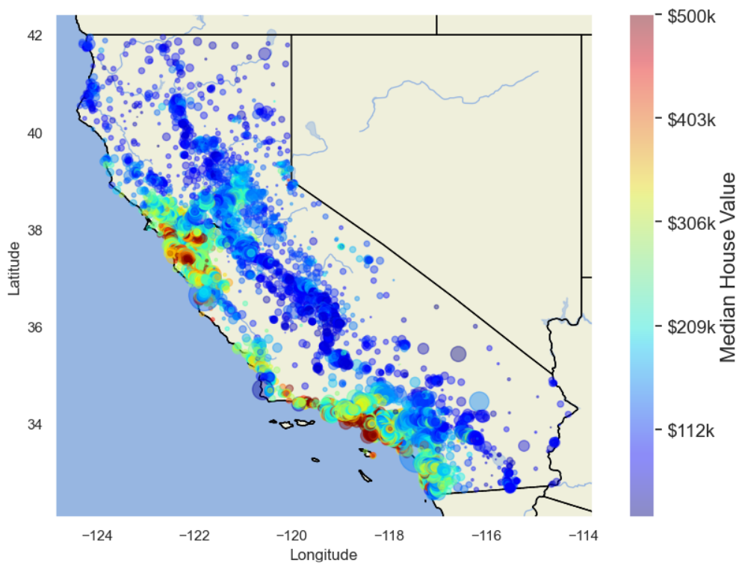
Topic: Predicting Housing Prices
The topic of our project was to create a machine learning model that is able to predict Housing prices based on various factors for Houses in California.

Slide 3

Reasoning
As future homeowners, we want to accurately predict how much it will cost to own homes with various features.

Slide 4



Questions to Answer
What features are most influential in determining Housing Price?
How is the house price data distributed?
Does there appear to be any underlying bias in the data?
How does RandomForest’s performance compare to XGBoost’s in this instance?

Slide 5
Taken from the 1990 Census concerning California home values.
The data set contains various features typically used to classify homes such as:
total rooms
total bedrooms
longitude/latitude.
Certain demographic metrics included within the housing data such as:
median income
housing median age
population
Data Description

Slide 6
Data Exploration
Started off with Housing data from Boston from 1978
Similar attributes to current data set but included:
CRIM: per capita crime rate by town
CHAS: Charles River Dummy Variable
DIS: weighted distances to five Boston Employment Centres
RAD: index of accessibility to radial highways
PTRATIO: Pupil-teacher ratio by town
B: attribute describing proportion of blacks by town
Discovered ethical concerns present with the Boston dataset and decided to reevaluate other datasets for information. Led to discovery of the current California Dataset with much more simplistic features and logical attributes.

Slide 7
Model Description
Started with a random forest model using the old Boston Data.
Reasoning: random forest decision trees are more robust vs. outliers/skewness, which we noticed were apparent in the data set.
Final Dataset created by creating new features based off of initial attributes of California Data Set. Features created included:
Bedrooms per room
Rooms per house
Population per House
Miles to nearest Major City
Second model to shift after first initial testing was XGBoosting:
Tested once more against both the old Boston data and the California Data.
Reasoning: gradient boosting increases the accuracy of decision tree models

Slide 8
Analysis Description
The linear regression model chosen allowed for exploratory data analysis on this given data set.
The analysis performed initial investigations on the data so as to discover:
patterns
spot anomalies
test hypothesis
check assumptions with the help of summary statistics and graphical representations

Slide 9
Dashboard Plan
Map of California comparing house location and price. This map will be interactive so the user navigate it easier.
House Values
Histogram to identify distribution
Graph comparing prices to different features to determine the most influential feature
Random Forest Performance
XGBoost’s Performance

Slide 10
Just one! Your own.
(With a little help from your smart phone)
Tip
Remember. If something sounds like common sense, people will ignore it.
Highlight what is unexpected about your topic.

Slide 11

The Google Translate app can repeat anything you say in up to NINETY LANGUAGES from German and Japanese to Czech and Zulu
Tip
Don’t wait till the end of the presentation to give the bottom line.
Reveal your product or idea (in this case a translation app) up front.

Slide 12
2. Examples
By the end of this section, your audience should be able to visualize:
What What is the pain you cure with your solution?
Who Show them a specific person who would benefit from your solution.

Slide 13

Meet Alberto.
He recently moved from Spain to a small town in Northern Ireland.
He loved soccer, but feared he had no way to talk to a coach or teammates.
Tip
Tell the audience about the problem through a story, ideally a person.

Slide 14

Meet Marcos.
He recently opened a camera shop near the Louvre in Paris.
Visitors to his store, mostly tourists, speak many different languages making anything beyond a simple transaction a challenge.
Tip
If one example isn’t sufficient to help people understand the breadth of your idea, pick a couple of examples.
Story for illustration purposes only

Slide 15

A translation barrier left Alberto feeling lonely and hurt Marco’s business.
Tip
Ideally, speak of people in very different situations, but where each could benefit from your solution.

Slide 16

Then, Marcos discovered Google Translate
He has his visiting customers speak their camera issues into the app.
He’s able to give them a friendly, personalized experience by understanding exactly what they need.

Slide 17

A simple gesture
Coaches Gary and Glen knew no Spanish.
They used Google Translate to invite Alberto to join in... “Do you want to play?”... “Can you defend the left side?”
Tip
Show how your solution helps the person in the story reach his or her goals.

Slide 18

From outsider to star
Alberto scored 30 goals in 21 games. He is now being scouted by several professional clubs in the Premier League. And he’s a favorite of the other boys on the team.
See a short video on Alberto’s story
Tip
Stories become more credible when they use concrete details such as the specific complex moves Alberto learned through Translate and his 30 goals in 21 games performance stats.

Slide 19
3. Examples
People need to understand how rare or frequent your examples are.
Pick 1 or 2 statistics and make them as concrete as possible. Stats are generally not sticky, but here are a few tactics:
Relate Deliver data within the context of a story you’ve already told
Compare Make big numbers digestible by putting them in the context of something familiar

Slide 20
It’s no surprise Marcos uses Google Translate in his shop regularly.
There are 23 officially recognized languages in the EU.
Tip
Don’t let data stand alone. Always relate it back to a story you’ve already told, in this case, Marco’s shop.
Source: theguardian.com

Slide 21


More than 50 million Americans travelled abroad in 2015
THAT’S MORE THAN THE POPULATION OF
CALIFORNIA AND TEXAS COMBINED
Tip
When a number is too large or too small to easily comprehend, clarify it with a comparison to something familiar.
Source: travel.trade.gov

Slide 22
4. Closing
Build confidence around your product or idea by including at least one of the these slides:
Milestones What has been accomplished and what might be left to tackle?
Testimonials Who supports your idea (or doesn’t)?
What’s next? How can the audience get involved or find out more?

Slide 23
Milestones
October 2014
October 2015
August 2015
November 2015
Translate web pages with Chrome extension
Translate text within an app
2014 |  |  |  | 2015
Translate conversations through your Android watch
Translate written text from English or German to Arabic with the click of a camera

Slide 24
What people are saying
With this app, I’m confident to plan a trip to rural Vietnam
Wendy Writer, CA
Visual translation feels like magic
Ronny Reader, NYC
Translate has officially inspired me to learn French
Abby Author, NYC
Quotes for illustration purposes only

Slide 25

Know a 2nd language? Make Google Translate even better by joining the community.
Tip
Inspire your audience to act on the information they just learned.
Depending on your idea, this can be anything from downloading an app to joining an organization.

Slide 26

Good luck!
We hope you’ll use these tips to go out and deliver a memorable pitch for your product or service!
For more (free) presentation tips relevant to other types of messages, go to heathbrothers.com/presentations
For more about making your ideas stick with others, check out our book!

